Slide 1
CAR DEKHO CASE STUDY Deepak Chawde

Slide 2
Overview
This document presents an SQL database analysis report for Car Dekho, focusing on essential car-related data.
The dataset includes information on car names, manufacturing years, selling prices, mileage, ownership history, transmission type, maximum power output, seating capacity, and more.
The analysis aims to extract actionable insights by querying and analyzing the data.
Key metrics to be examined include selling price trends over manufacturing years, the impact of mileage on resale value, transmission type preferences, correlation between maximum power output and selling price, and the influence of seating capacity on market demand.
SQL queries and data visualization techniques will be utilized to gain a deeper understanding of factors driving the automotive market.
- The findings will facilitate informed decision-making and strategic planning for Car Dekho.

Slide 3

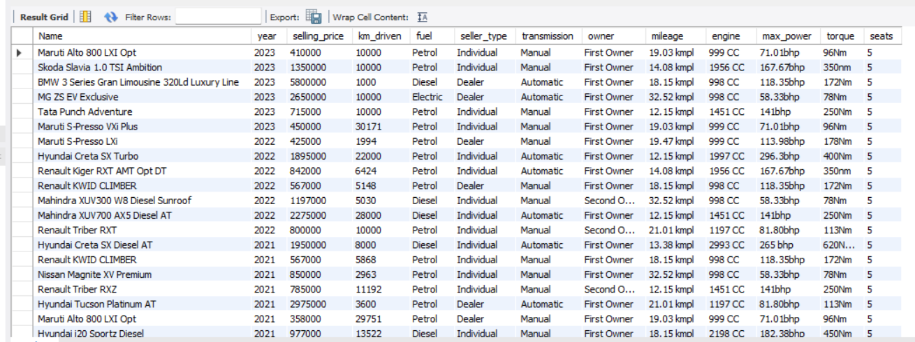
-- Read data

Slide 4
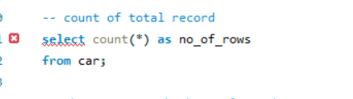
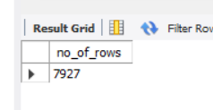
-- count of total record

Slide 5
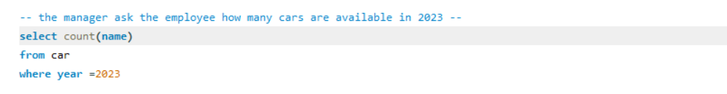
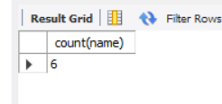
-- the manager ask the employee how many cars are available in 2023 --

Slide 6
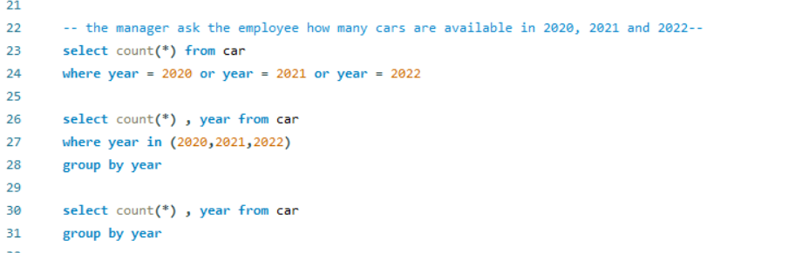
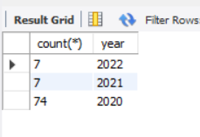
-- the manager ask the employee how many cars are available in 2020, 2021 and 2022--

Slide 7
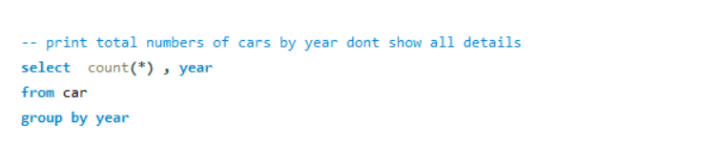
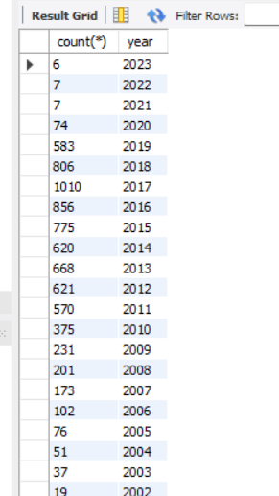
-- print total numbers of cars by year dont show all details

Slide 8
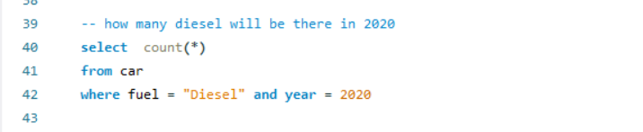
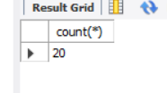
-- how many diesel will be there in 2020

Slide 9
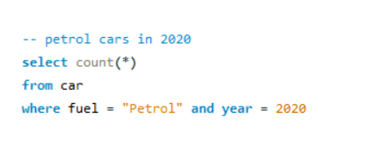
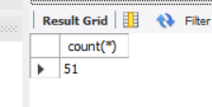
-- petrol cars in 2020

Slide 10
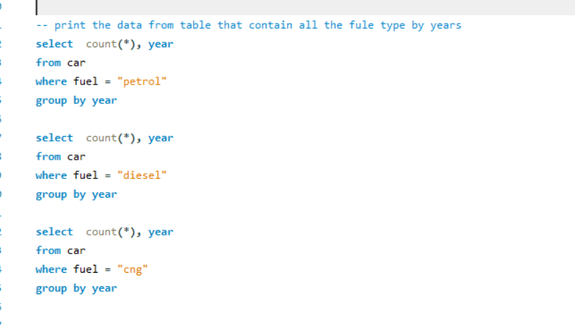
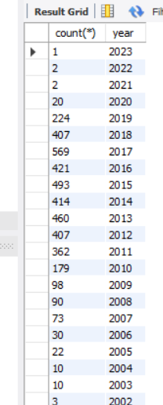
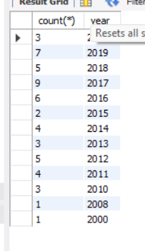
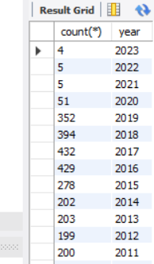
-- print the data from table that contain all the fule type by years

Slide 11
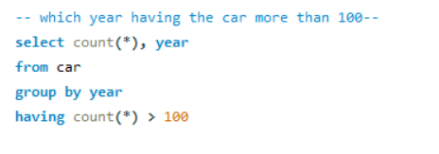
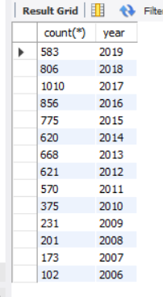
-- which year having the car more than 100--

Slide 12
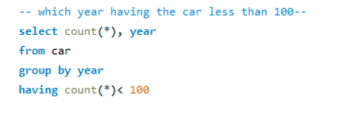
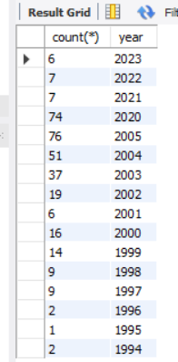
-- which year having the car less than 100--

Slide 13
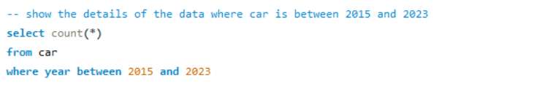

-- show the details of the data where car is between 2015 and 2023

Slide 14
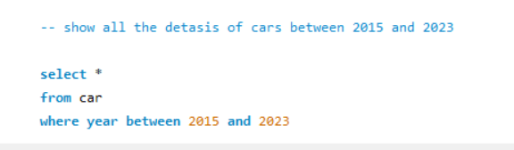
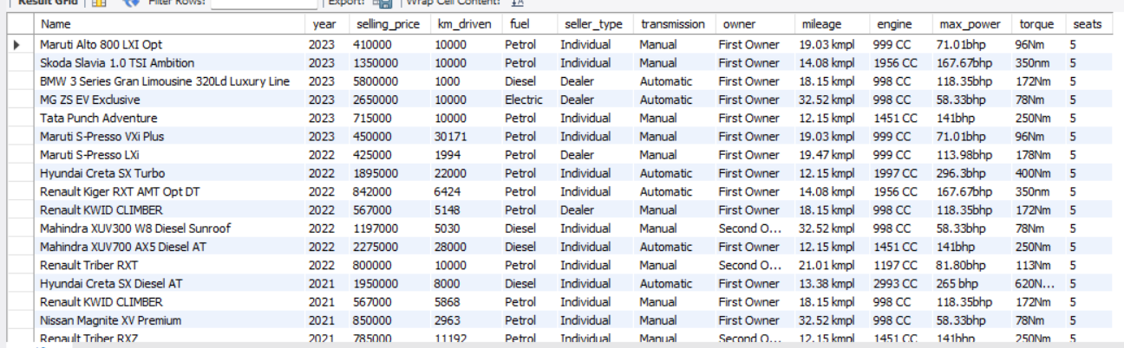
-- show the details of the data where car is between 2015 and 2023

Slide 15
Thank You

